Slide 1

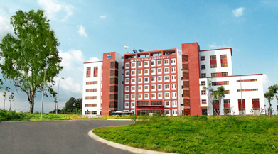
International University
MICRO-PROCESSING SYSTEM
Lecture 12:
Controller Area Network
Vo Minh Thanh, M.Eng
School Of Electrical Engineering

Slide 2
Intra-vehicular communication
A typical vehicle has a large number of electronic control systems
Some of such control systems
  Engine timing
  Gearbox and carburetor throttle control
  Anti-block systems (ABS)
  Acceleration skid control (ASC)
The growth of automotive electronics is a result of:
  Customers wish for better comfort and better safety.
  Government requirements for improved emission control
  Reduced fuel consumption

Slide 3
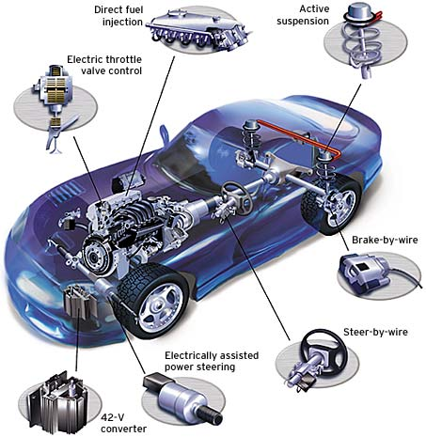
What are some real world applications of CAN?
  Controller Area Networks are used in many different fields, the bulk of which are
    Auto-motive industry
    Factory Automation
    Machine Control
    Medical Equipment and devices
    And more….

Slide 4
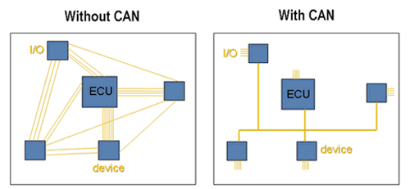
What is CAN and what are some of its features?
Serial communication
Multi-Master Protocol
Compact
  Twisted Pair Bus line
1 Megabit per second

Slide 5
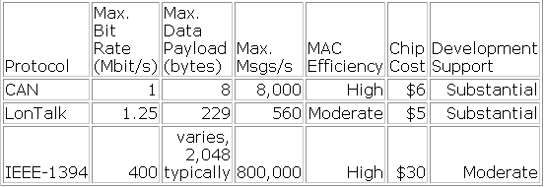
Why is CAN used?
  Robust in noisy environments
  Priority Signal Setting
  All devices on the network receive every bit of information sent on the BUS
  Cost Effective

Slide 6
Controller Area Network (CAN)
Controller Area Network (CAN) is a fast serial bus that is designed to provide
  an efficient,
  Reliable and
  Very economical link between sensors and actuators.
CAN uses a twisted pair cable to communicate at speeds up to 1Mbit/s with up to 40 devices.
Originally developed to simplify the wiring in automobiles.
CAN fieldbuses are now used in machine and factory automation products as well.

Slide 7
CAN features
Any node can access the bus when the bus is quiet
Non-destructive bit-wise arbitration to allow 100% use of the bandwidth without loss of data
Variable message priority based on 11-bit (or 29 bit) packet identifier
Peer-to-peer and multi-cast reception
Automatic error detection, signaling and retries
Data packets are 8 bytes long

Slide 8
Tradeoff: CAN bus versus point-to-point connections
By introducing one single bus as the only means of communication as opposed to the point-to-point network, we traded off the channel access simplicity for the circuit simplicty
Since two devices might want to transmit simultaneously, we need to have a MAC protocol to handle the situation.
CAN manages MAC issues by using a unique identifier for each of the outgoing messages
Identifier of a message represents its priority.

Slide 9
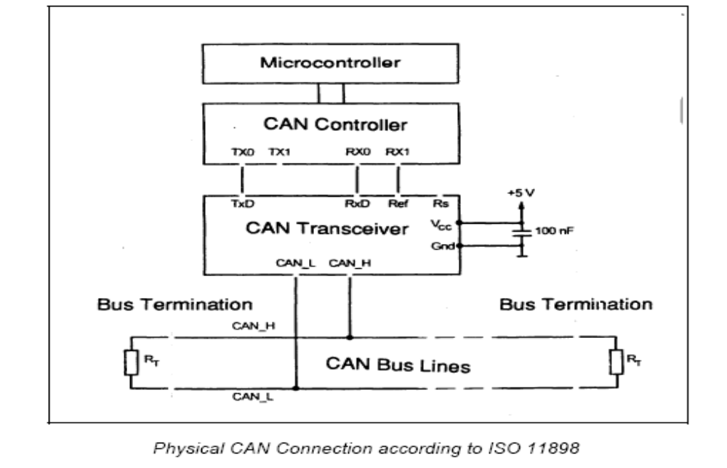
Physical CAN connection

Slide 10
CAN
CAN Station 1
CAN Station 5
CS1
CS2
CS3
CS4
CS5
CAN BUS

Slide 11
CAN Protocol - Version 2.0 A(standard)/B(Extended)
• A: Object, Transfer, and Physical Layers
– Object Layer: handles messages - selects transmit/receive
messages
– Transfer Layer: assures messages adheres to protocol
– Physical Layer: sends and receives messages
• B: Data Link Layer and Physical Layer

Slide 12
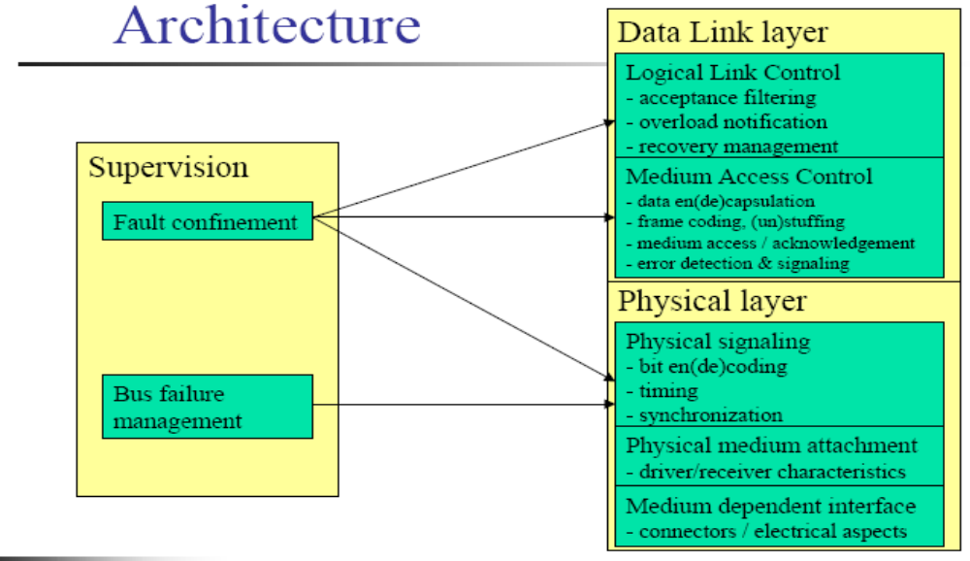

Slide 13
Physical Layer
Topology
- Terminated bus
Number of stations
-In principle limited to 30 (depends on drivers)
Medium
- Twisted pair, single wire
Range
-Signaling speed and propagation speed dependent: 40m at 1Mbit/s
-Drop length limited to 30 cm
Signaling and bit encoding
-10 kbit/s to 1 Mbit/s, NRZ

Slide 14
Physical Layer
Synchronization
- Uses signal edges (implies bit stuffing with NRZ)
- After Five consecutive ones, a zero is inserted
- After Five consecutive zeros, a one is inserted
-This rules includes a possible stuffing bit inserted before
Signals
- Recessive: logical “1”
- Dominant: logical “0”
- When two stations compete on a bit by bit basis, the station that emits dominant bit imposes this level on the bus

Slide 15
Basic message frame format
Field name | Length (bits) | Purpose
Start-of-frame | 1 | Denotes the start of frame transmission
Identifier | 11 | A (unique) identifier for the data
Remote transmission request (RTR) | 1 | Must be dominant (0)
Identifier extension bit (IDE) | 1 | Must be dominant (0)
Reserved bit (r0) | 1 | Reserved bit (it must be set to dominant (0), but accepted as either dominant or recessive)
Data length code (DLC) | 4 | Number of bytes of data (0-8 bytes)
Data field | 0-8 bytes | Data to be transmitted (length dictated by DLC field)
CRC | 15 | Cyclic redundancy check
CRC delimiter | 1 | Must be recessive (1)
ACK slot | 1 | Transmitter sends recessive (1) and any receiver can assert a dominant (0)
ACK delimiter | 1 | Must be recessive (1)
End-of-frame (EOF) | 7 | Must be recessive (1)

Slide 16
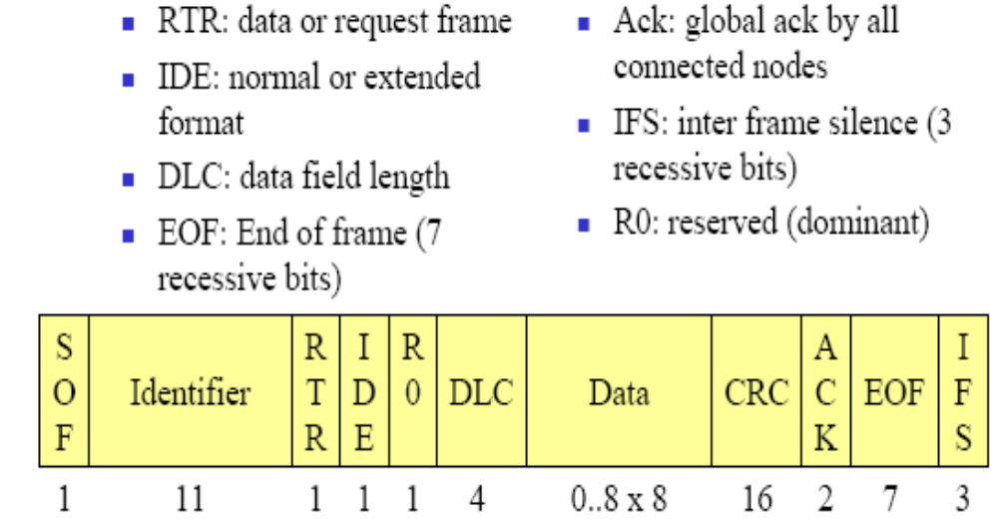
Medium Access Control Frame

Slide 17
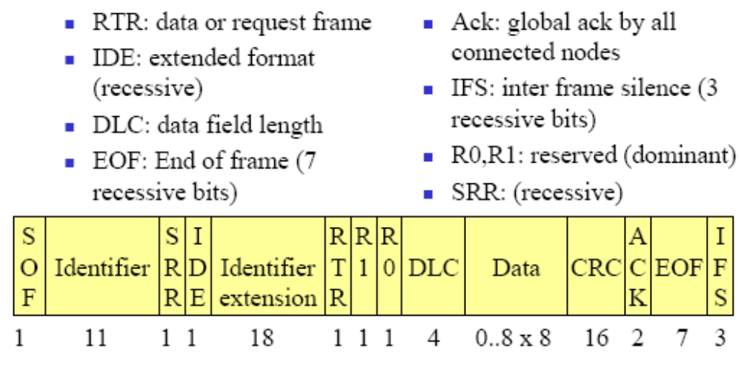
Extended Addressing

Slide 18
Addressing
Single 11 or 29 bit identifier per frame
  If used to identify a node
    Source(data) or Destination(request) of the message
  Normally used to identify the payload
  A lower value gives higher value in contention,

Slide 19
References
http://www.fieldbus.com.au/techinfo.htm#Top
http://www.esd-electronics.com/german/PDF-file/CAN/Englisch/intro-e.pdf
http://www.eng.man.ac.uk/mech/merg/FieldbusTeam/Fieldbus%20Introduction.htm#_Toc487265349

